Slide 1
Dataset of real-world industrial vibration data collected from a brownfield CNC milling machine.
Name: Yvan Ntabashwa.
Course: MEM 679
Using Vibration Data for Anomaly Detection and
Maintenance Optimization

Slide 2
Introduction
Brownfield CNC milling machines are older, pre-existing machines in manufacturing plants that have been integrated into modern systems rather than being newly installed. These machines are essential in production lines where they execute precise material cutting, shaping, and finishing, contributing to the manufacture of complex parts across sectors like automotive, aerospace, and electronics.
However, as they age, brownfield CNC machines are more prone to failures due to wear and outdated components. Machine failures disrupt production, leading to unplanned downtime, lower productivity, and increased operational costs due to repair needs and delayed manufacturing schedules.

Slide 3
Dataset description
The dataset provided is a collection of real-world industrial vibration data collected from a brownfield CNC milling machine. The acceleration has been measured using a tri-axial accelerometer (Bosch CISS Sensor) mounted inside the machine. The X- Y- and Z-axes of the accelerometer have been recorded using a sampling rate equal to 2 kHz. Thereby normal as well as anomoulous data have been collected for 6 different timeframes, each lasting 6 months from October 2018 until August 2021 and labelled accordingly. It can be used to investigate the scalability of models and research process variations as the anomaly impact differs. In total there is data from three different CNC milling machines each executing 15 processes. For a detailed description of the data and experimental set-up,
Source : https://www.kaggle.com/datasets/maximilianfellhuber/cnc-machining-data?resource=download

Slide 4
Data Visualization
Static Visualizations
For static visualization I used :
Line Plot: The line plot will help us visualize the vibration magnitude over time and also to observe trends and anomalies by :
Highlighting abnormal spikes and deviations where such spikes might indicate potential failure.
2. Histogram:Will help us visualize the distribution of vibration magnitudes by showing thresholds for "normal" vs. "anomalous" magnitudes

Slide 5
Line Plot of Vibration Magnitude Over Sample Index
Objective:
Visualize trends in vibration magnitude to detect anomalies or irregular patterns.
Provide insights into how machine vibrations fluctuate during operation.

Slide 6
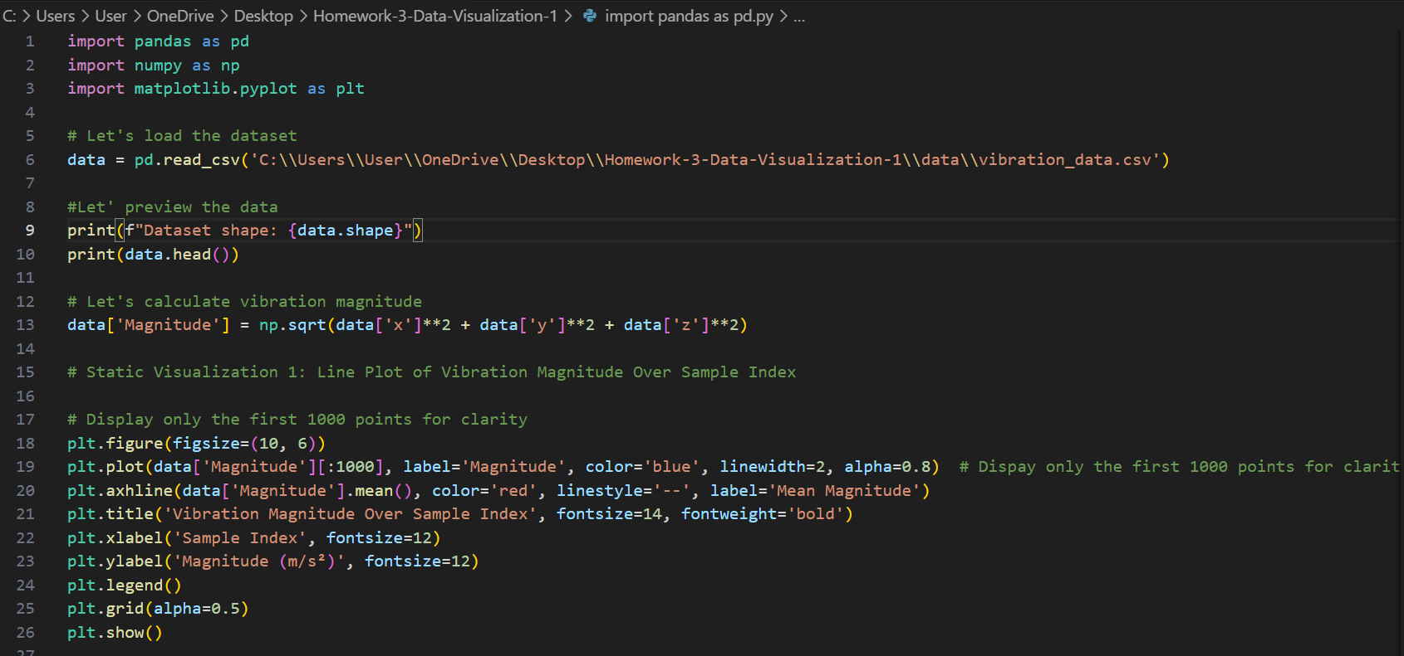

Slide 7
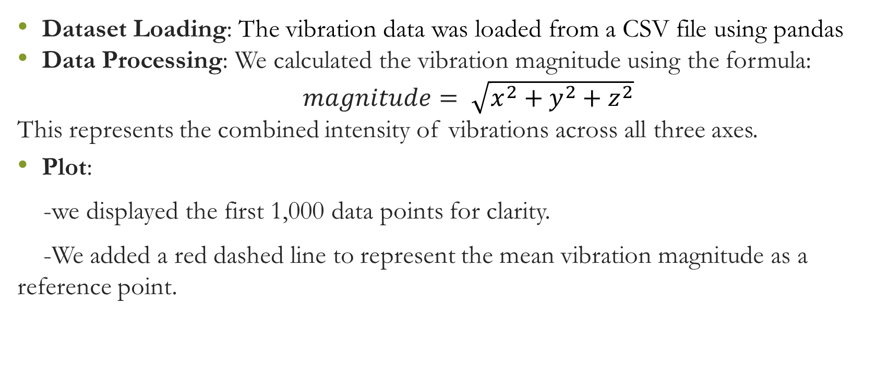
Code Explanation
Dataset Loading: The vibration data was loaded from a CSV file using pandas
Data Processing: We calculated the vibration magnitude using the formula:
$magnitude= \sqrt{x^{2}+y^{2}+z^{2}}$
This represents the combined intensity of vibrations across all three axes.
Plot:
-we displayed the first 1,000 data points for clarity.
-We added a red dashed line to represent the mean vibration magnitude as a reference point.

Slide 8
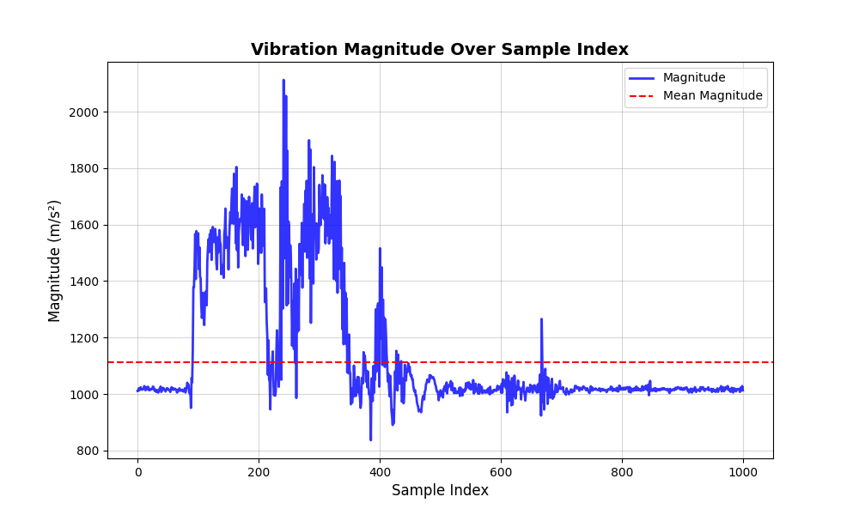

Slide 9
Graph Details
X-axis: Sample Index (time sequence of vibration data points).
Y-axis: Vibration Magnitude (m/s²).
Red Dashed Line: Mean magnitude, to compare normal vs. anomalous values.
Grid: Included for better readability.

Slide 10
Insights from the Plot
Regular patterns in the vibration magnitude indicate normal machine operation.
Spikes above the mean line represent potential anomalies or irregular behavior,
which could indicate mechanical wear, misalignment, or other issues.
Why This Visualization Matters:
It provides a clear, visual representation of the machine's behavior over time.
Helps maintenance teams quickly identify periods of abnormal vibration,
enabling proactive interventions to prevent breakdowns.

Slide 11
How It Supports the Project Goals
The line plot is a foundational tool for understanding vibration trends.
It complements advanced machine learning models by visualizing the raw data
used for training and anomaly detection.

Slide 12
Histogram
Purpose:
The histogram visualizes the distribution of vibration magnitudes, helping to identify the most common vibration levels and potential outliers.
This supports understanding normal machine behavior and detecting irregularities.

Slide 13
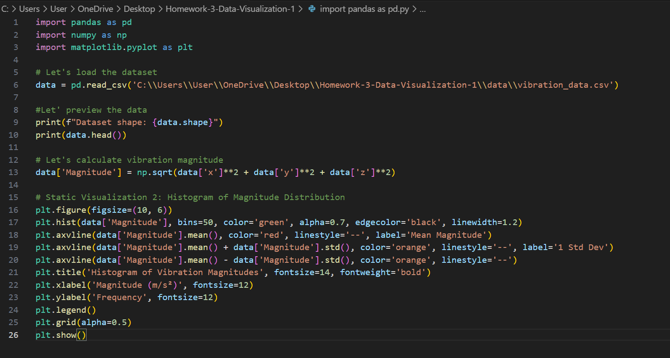

Slide 14
Code explainations
Plotted Histogram:
Divided the magnitude data into 50 bins to represent the frequency distribution of vibration magnitudes.
Highlighted key statistical thresholds:
Red dashed line: Mean vibration magnitude.
Orange dashed lines: ±1 standard deviation from the mean, indicating the range of typical variations.

Slide 15
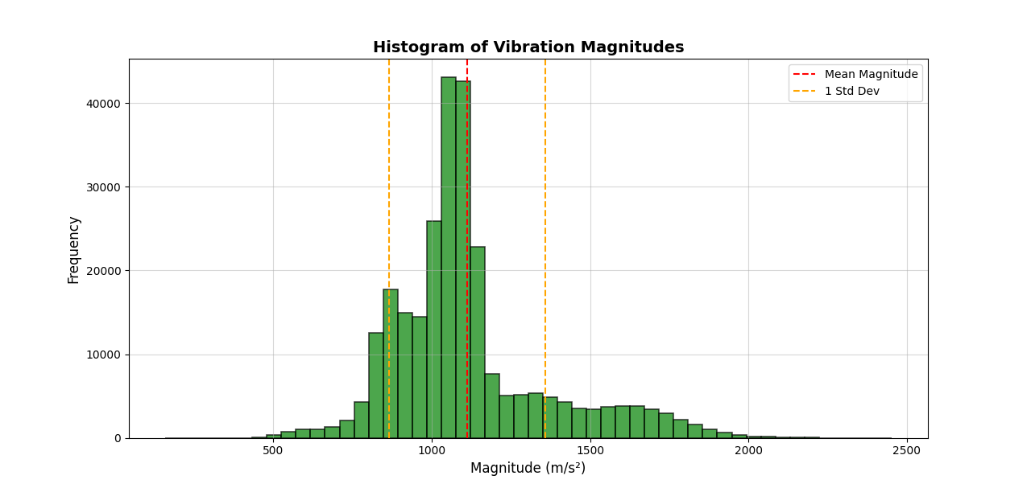

Slide 16
Insights from the Histogram
The majority of vibration magnitudes cluster around the mean, showing
consistent normal operation.
Values beyond ±1 standard deviation represent potential outliers, indicating
unusual or anomalous behavior that might require attention.
This visualization helps identify thresholds for normal vs. anomalous vibrations,
which is critical for anomaly detection

Slide 17
Vibration Dashboard
http://127.0.0.1:8050

Slide 18
Conclusion
The Data analysis through visualization of datas will have a big operational impact in manufacturing where :
There will be a reduced downtime and maintenance costs.
Extended equipment lifespan.
Improved production efficiency

